Slide 1
British Airways
A Sentiment Analysis of the Airline Service’s Customer Reviews

Slide 2
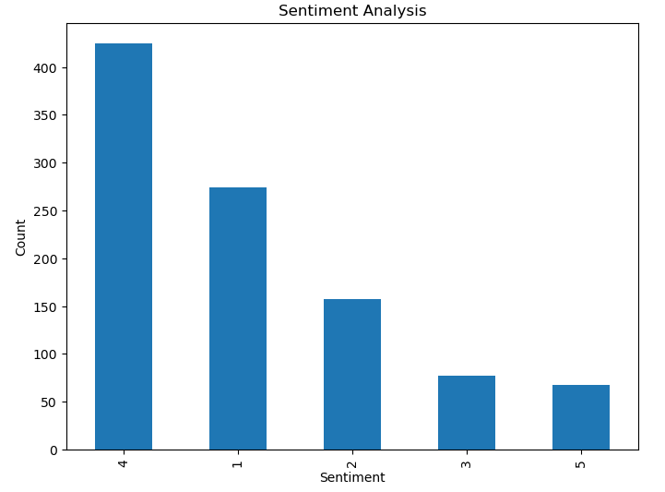
Sentiment Analysis
From the reviews’ analysis, over 26% of customers were grossly displeased by the airline's services(1 star) , in contrast, over 46% were pleased (4 stars) and less than 10% of total customers were greatly pleased (5 stars).
I believe the specificities of their displeasures can be addressed strictly and with open mindedness.

